Slide 1
LINE AUTOMATION PROPOSAL
START
INSPECTION : RUNNING INSPECTION
SCAN FOR MODEL THAT WILL BE IN PRODUCTION
INSPECTION 5: FINAL INSPECTION
SFIS 1: FAN MOTOR & COMPRESSOR RECORDING and CHECKING
SFIS 5: PACKAGING
INSPECTION 1: AIRTIGHT TEST
END
SFIS 2: GAS CHARGING
SFIS 3: INDOOR CONTROL BOARD
SFIS 4: CONTROL BOARD & OUTDOOR PCB
INSPECTION 2: WIRING AND CONSTRUCTION INSPECTION

Slide 2
LINE AUTOMATION PROPOSAL
START
INSPECTION : RUNNING INSPECTION
SCAN FOR MODEL THAT WILL BE IN PRODUCTION
SFIS 1: FAN MOTOR & COMPRESSOR RECORDING and CHECKING
INSPECTION 5: FINAL INSPECTION
INSPECTION 1: AIRTIGHT TEST
SFIS 5: PACKAGING
SFIS 2: GAS CHARGING
END
SFIS 4: CONTROL BOARD & OUTDOOR PCB
SFIS 3: INDOOR CONTROL BOARD
INSPECTION 2: WIRING AND CONSTRUCTION INSPECTION
Scan Safety Parts
EXPANSION VALVE ASSY
EXPANSION COIL
REACTOR
V COIL
FOUR WAY VALVE

Slide 3
LINE AUTOMATION PROPOSAL
START
INSPECTION : RUNNING INSPECTION
SCAN FOR MODEL THAT WILL BE IN PRODUCTION
SFIS 1: FAN MOTOR & COMPRESSOR RECORDING and CHECKING
INSPECTION 5: FINAL INSPECTION
INSPECTION 1: AIRTIGHT TEST
SFIS 5: PACKAGING
SFIS 2: GAS CHARGING
END
SFIS 4: CONTROL BOARD & OUTDOOR PCB
SFIS 3: INDOOR CONTROL BOARD
INSPECTION 2: WIRING AND CONSTRUCTION INSPECTION
Scan Model, Fan Motor, and Compressor
MODEL
SERIAL
INDOOR FM
OUTDOOR FM
COMPRESSOR

Slide 4
LINE AUTOMATION PROPOSAL
START
INSPECTION : RUNNING INSPECTION
SCAN FOR MODEL THAT WILL BE IN PRODUCTION
SFIS 1: FAN MOTOR & COMPRESSOR RECORDING and CHECKING
INSPECTION 5: FINAL INSPECTION
INSPECTION 1: AIRTIGHT TEST
SFIS 5: PACKAGING
SFIS 2: GAS CHARGING
END
SFIS 4: CONTROL BOARD & OUTDOOR PCB
SFIS 3: INDOOR CONTROL BOARD
INSPECTION 2: WIRING AND CONSTRUCTION INSPECTION
Details
Sequence | Model | Serial | Time | Details

Slide 5
LINE AUTOMATION PROPOSAL
START
INSPECTION : RUNNING INSPECTION
SCAN FOR MODEL THAT WILL BE IN PRODUCTION
SFIS 1: FAN MOTOR & COMPRESSOR RECORDING and CHECKING
INSPECTION 5: FINAL INSPECTION
INSPECTION 1: AIRTIGHT TEST
SFIS 5: PACKAGING
SFIS 2: GAS CHARGING
END
SFIS 4: CONTROL BOARD & OUTDOOR PCB
SFIS 3: INDOOR CONTROL BOARD
INSPECTION 2: WIRING AND CONSTRUCTION INSPECTION
Schedule
Model | Plan | Act | Variance

Slide 6
LINE AUTOMATION PROPOSAL
START
INSPECTION : RUNNING INSPECTION
SCAN FOR MODEL THAT WILL BE IN PRODUCTION
SFIS 1: FAN MOTOR & COMPRESSOR RECORDING and CHECKING
INSPECTION 5: FINAL INSPECTION
INSPECTION 1: AIRTIGHT TEST
SFIS 5: PACKAGING
SFIS 2: GAS CHARGING
END
SFIS 4: CONTROL BOARD & OUTDOOR PCB
SFIS 3: INDOOR CONTROL BOARD
INSPECTION 2: WIRING AND CONSTRUCTION INSPECTION
Scan Model and Airtight Test
MODEL
SERIAL
GOOD
NO GOOD

Slide 7
LINE AUTOMATION PROPOSAL
START
INSPECTION : RUNNING INSPECTION
SCAN FOR MODEL THAT WILL BE IN PRODUCTION
SFIS 1: FAN MOTOR & COMPRESSOR RECORDING and CHECKING
INSPECTION 5: FINAL INSPECTION
INSPECTION 1: AIRTIGHT TEST
SFIS 5: PACKAGING
SFIS 2: GAS CHARGING
END
SFIS 4: CONTROL BOARD & OUTDOOR PCB
SFIS 3: INDOOR CONTROL BOARD
INSPECTION 2: WIRING AND CONSTRUCTION INSPECTION
Scan Brazing Part and Operator
BRAZING PART
NAME
BRAZING PART
NAME
BRAZING PART
NAME
BRAZING PART
NAME
BRAZING PART
NAME
BRAZING PART
NAME

Slide 8
LINE AUTOMATION PROPOSAL
START
INSPECTION : RUNNING INSPECTION
SCAN FOR MODEL THAT WILL BE IN PRODUCTION
SFIS 1: FAN MOTOR & COMPRESSOR RECORDING and CHECKING
INSPECTION 5: FINAL INSPECTION
INSPECTION 1: AIRTIGHT TEST
SFIS 5: PACKAGING
SFIS 2: GAS CHARGING
END
SFIS 4: CONTROL BOARD & OUTDOOR PCB
SFIS 3: INDOOR CONTROL BOARD
INSPECTION 2: WIRING AND CONSTRUCTION INSPECTION
Scan Model and Get Gas Charge
MODEL
SERIAL
GET GAS

Slide 9
LINE AUTOMATION PROPOSAL
START
INSPECTION : RUNNING INSPECTION
SCAN FOR MODEL THAT WILL BE IN PRODUCTION
SFIS 1: FAN MOTOR & COMPRESSOR RECORDING and CHECKING
INSPECTION 5: FINAL INSPECTION
INSPECTION 1: AIRTIGHT TEST
SFIS 5: PACKAGING
SFIS 2: GAS CHARGING
END
SFIS 4: CONTROL BOARD & OUTDOOR PCB
SFIS 3: INDOOR CONTROL BOARD
INSPECTION 2: WIRING AND CONSTRUCTION INSPECTION
Sequence | Model | Serial | Time | Gas Charge

Slide 10
LINE AUTOMATION PROPOSAL
START
INSPECTION : RUNNING INSPECTION
SCAN FOR MODEL THAT WILL BE IN PRODUCTION
SFIS 1: FAN MOTOR & COMPRESSOR RECORDING and CHECKING
INSPECTION 5: FINAL INSPECTION
INSPECTION 1: AIRTIGHT TEST
SFIS 5: PACKAGING
SFIS 2: GAS CHARGING
END
SFIS 4: CONTROL BOARD & OUTDOOR PCB
SFIS 3: INDOOR CONTROL BOARD
INSPECTION 2: WIRING AND CONSTRUCTION INSPECTION
Model | Plan | Act | Variance

Slide 11
LINE AUTOMATION PROPOSAL
START
INSPECTION : RUNNING INSPECTION
SCAN FOR MODEL THAT WILL BE IN PRODUCTION
SFIS 1: FAN MOTOR & COMPRESSOR RECORDING and CHECKING
INSPECTION 5: FINAL INSPECTION
INSPECTION 1: AIRTIGHT TEST
SFIS 5: PACKAGING
SFIS 2: GAS CHARGING
END
SFIS 4: CONTROL BOARD & OUTDOOR PCB
SFIS 3: INDOOR CONTROL BOARD
INSPECTION 2: WIRING AND CONSTRUCTION INSPECTION
Scan Safety Parts
SP1
SP2
SP3
SP4
SP5

Slide 12
LINE AUTOMATION PROPOSAL
START
INSPECTION : RUNNING INSPECTION
SCAN FOR MODEL THAT WILL BE IN PRODUCTION
SFIS 1: FAN MOTOR & COMPRESSOR RECORDING and CHECKING
INSPECTION 5: FINAL INSPECTION
INSPECTION 1: AIRTIGHT TEST
SFIS 5: PACKAGING
SFIS 2: GAS CHARGING
END
SFIS 4: CONTROL BOARD & OUTDOOR PCB
SFIS 3: INDOOR CONTROL BOARD
INSPECTION 2: WIRING AND CONSTRUCTION INSPECTION
Scan Model and Control Boards
MODEL
SERIAL
CONTROL BOARD SERIAL
OUTDOOR BOARD
AIRCON WIFI SERIAL

Slide 13
LINE AUTOMATION PROPOSAL
START
INSPECTION : RUNNING INSPECTION
SCAN FOR MODEL THAT WILL BE IN PRODUCTION
SFIS 1: FAN MOTOR & COMPRESSOR RECORDING and CHECKING
INSPECTION 5: FINAL INSPECTION
INSPECTION 1: AIRTIGHT TEST
SFIS 5: PACKAGING
SFIS 2: GAS CHARGING
END
SFIS 4: CONTROL BOARD & OUTDOOR PCB
SFIS 3: INDOOR CONTROL BOARD
INSPECTION 2: WIRING AND CONSTRUCTION INSPECTION
Details
Sequence | Model | Serial | Time | Details

Slide 14
LINE AUTOMATION PROPOSAL
START
INSPECTION : RUNNING INSPECTION
SCAN FOR MODEL THAT WILL BE IN PRODUCTION
SFIS 1: FAN MOTOR & COMPRESSOR RECORDING and CHECKING
INSPECTION 5: FINAL INSPECTION
INSPECTION 1: AIRTIGHT TEST
SFIS 5: PACKAGING
SFIS 2: GAS CHARGING
END
SFIS 4: CONTROL BOARD & OUTDOOR PCB
SFIS 3: INDOOR CONTROL BOARD
INSPECTION 2: WIRING AND CONSTRUCTION INSPECTION
Schedule
Model | Plan | Act | Variance

Slide 15
LINE AUTOMATION PROPOSAL
START
INSPECTION : RUNNING INSPECTION
SCAN FOR MODEL THAT WILL BE IN PRODUCTION
SFIS 1: FAN MOTOR & COMPRESSOR RECORDING and CHECKING
INSPECTION 5: FINAL INSPECTION
INSPECTION 1: AIRTIGHT TEST
SFIS 5: PACKAGING
SFIS 2: GAS CHARGING
END
SFIS 4: CONTROL BOARD & OUTDOOR PCB
SFIS 3: INDOOR CONTROL BOARD
INSPECTION 2: WIRING AND CONSTRUCTION INSPECTION
Scan Model and Wiring and Construction Inspection
MODEL
SERIAL
GOOD
NO GOOD

Slide 16
LINE AUTOMATION PROPOSAL
START
INSPECTION : RUNNING INSPECTION
SCAN FOR MODEL THAT WILL BE IN PRODUCTION
SFIS 1: FAN MOTOR & COMPRESSOR RECORDING and CHECKING
INSPECTION 5: FINAL INSPECTION
INSPECTION 1: AIRTIGHT TEST
SFIS 5: PACKAGING
SFIS 2: GAS CHARGING
END
SFIS 4: CONTROL BOARD & OUTDOOR PCB
SFIS 3: INDOOR CONTROL BOARD
INSPECTION 2: WIRING AND CONSTRUCTION INSPECTION
Scan Model and Inspection
MODEL
SERIAL
GOOD
NO GOOD

Slide 17
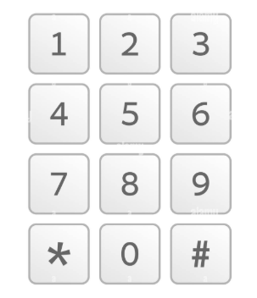
LINE AUTOMATION PROPOSAL
START
INSPECTION : RUNNING INSPECTION
SCAN FOR MODEL THAT WILL BE IN PRODUCTION
SFIS 1: FAN MOTOR & COMPRESSOR RECORDING and CHECKING
INSPECTION 5: FINAL INSPECTION
INSPECTION 1: AIRTIGHT TEST
SFIS 5: PACKAGING
SFIS 2: GAS CHARGING
END
SFIS 4: CONTROL BOARD & OUTDOOR PCB
SFIS 3: INDOOR CONTROL BOARD
INSPECTION 2: WIRING AND CONSTRUCTION INSPECTION
Scan Model and Inspection
MODEL
SERIAL
CURRENT
CURRENT
POWER
POWER
TEMP. DIFF
TEMP. DIFF

Slide 18
LINE AUTOMATION PROPOSAL
START
INSPECTION : RUNNING INSPECTION
SCAN FOR MODEL THAT WILL BE IN PRODUCTION
SFIS 1: FAN MOTOR & COMPRESSOR RECORDING and CHECKING
INSPECTION 5: FINAL INSPECTION
INSPECTION 1: AIRTIGHT TEST
SFIS 5: PACKAGING
SFIS 2: GAS CHARGING
END
SFIS 4: CONTROL BOARD & OUTDOOR PCB
SFIS 3: INDOOR CONTROL BOARD
INSPECTION 2: WIRING AND CONSTRUCTION INSPECTION
Scan Model and Inspection
MODEL
SERIAL
GOOD
NO GOOD

Slide 19
LINE AUTOMATION PROPOSAL
START
INSPECTION : RUNNING INSPECTION
SCAN FOR MODEL THAT WILL BE IN PRODUCTION
SFIS 1: FAN MOTOR & COMPRESSOR RECORDING and CHECKING
INSPECTION 5: FINAL INSPECTION
INSPECTION 1: AIRTIGHT TEST
SFIS 5: PACKAGING
SFIS 2: GAS CHARGING
END
SFIS 4: CONTROL BOARD & OUTDOOR PCB
SFIS 3: INDOOR CONTROL BOARD
INSPECTION 2: WIRING AND CONSTRUCTION INSPECTION
Scan Model and Inspection
MODEL
SERIAL
CURRENT
CURRENT

Slide 20
LINE AUTOMATION PROPOSAL
START
INSPECTION : RUNNING INSPECTION
SCAN FOR MODEL THAT WILL BE IN PRODUCTION
SFIS 1: FAN MOTOR & COMPRESSOR RECORDING and CHECKING
INSPECTION 5: FINAL INSPECTION
INSPECTION 1: AIRTIGHT TEST
SFIS 5: PACKAGING
SFIS 2: GAS CHARGING
END
SFIS 4: CONTROL BOARD & OUTDOOR PCB
SFIS 3: INDOOR CONTROL BOARD
INSPECTION 2: WIRING AND CONSTRUCTION INSPECTION
Scan Model and CC Case
MODEL
SERIAL
CC. Case

Slide 21
LINE AUTOMATION PROPOSAL
START
INSPECTION : RUNNING INSPECTION
SCAN FOR MODEL THAT WILL BE IN PRODUCTION
SFIS 1: FAN MOTOR & COMPRESSOR RECORDING and CHECKING
INSPECTION 5: FINAL INSPECTION
INSPECTION 1: AIRTIGHT TEST
SFIS 5: PACKAGING
SFIS 2: GAS CHARGING
END
SFIS 4: CONTROL BOARD & OUTDOOR PCB
SFIS 3: INDOOR CONTROL BOARD
INSPECTION 2: WIRING AND CONSTRUCTION INSPECTION
Sequence | Model | Serial | Time | Gas Charge

Slide 22
LINE AUTOMATION PROPOSAL
START
INSPECTION : RUNNING INSPECTION
SCAN FOR MODEL THAT WILL BE IN PRODUCTION
SFIS 1: FAN MOTOR & COMPRESSOR RECORDING and CHECKING
INSPECTION 5: FINAL INSPECTION
INSPECTION 1: AIRTIGHT TEST
SFIS 5: PACKAGING
SFIS 2: GAS CHARGING
END
SFIS 4: CONTROL BOARD & OUTDOOR PCB
SFIS 3: INDOOR CONTROL BOARD
INSPECTION 2: WIRING AND CONSTRUCTION INSPECTION
Model | Plan | Act | Variance

Slide 23
LINE AUTOMATION PROPOSAL
WORK SCHEDULE
QC REPORT
MODEL REFERENCE
TRANSFER SLIP
MODULE CONTROL

Slide 24
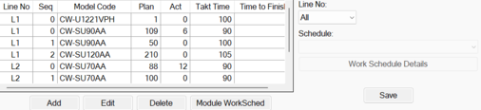
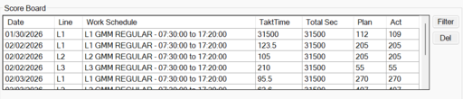
LINE AUTOMATION PROPOSAL
WORK SCHEDULE

Slide 25
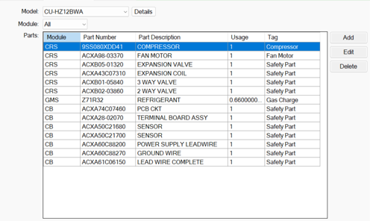
LINE AUTOMATION PROPOSAL
MODEL REFERENCE

Slide 26
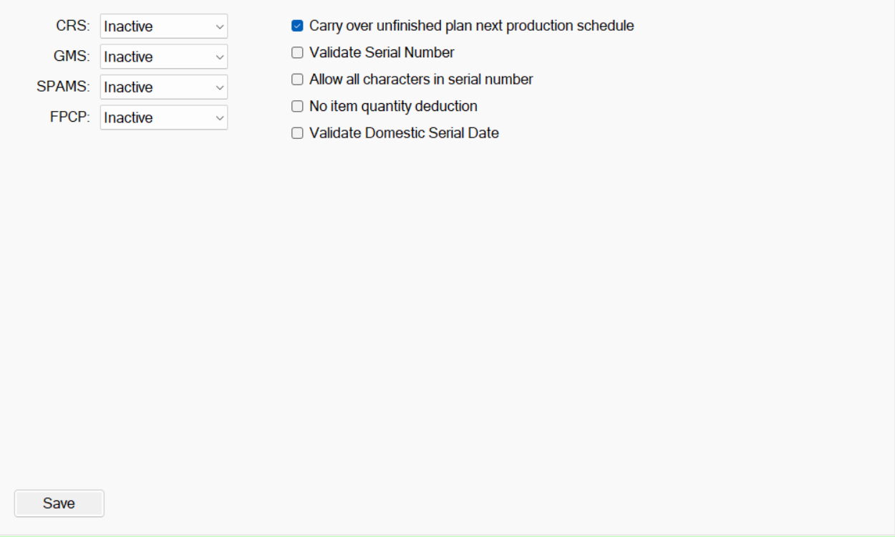
LINE AUTOMATION PROPOSAL
MODULE CONTROL

Slide 27
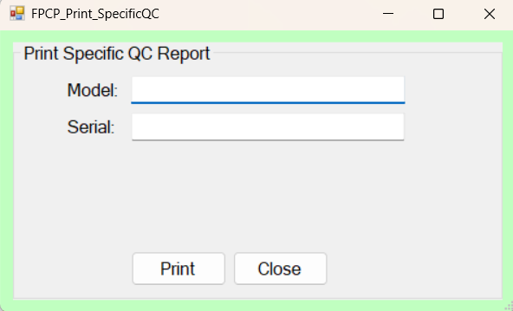
LINE AUTOMATION PROPOSAL
QC REPORT

Slide 28
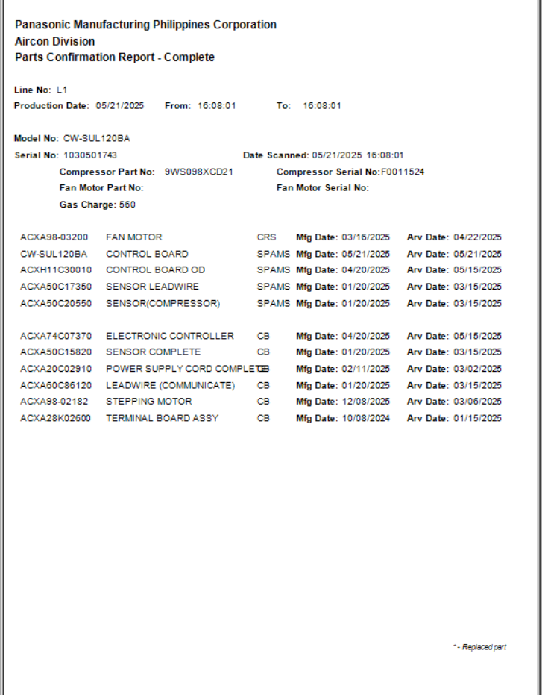
LINE AUTOMATION PROPOSAL
QC REPORT
Note: QC Report shall be complete w/ judgement and name of operator

Slide 29
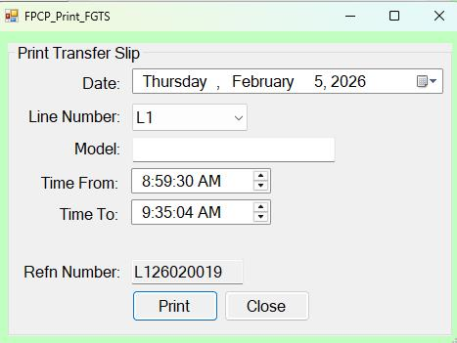
LINE AUTOMATION PROPOSAL
TRANSFER SLIP

Slide 30
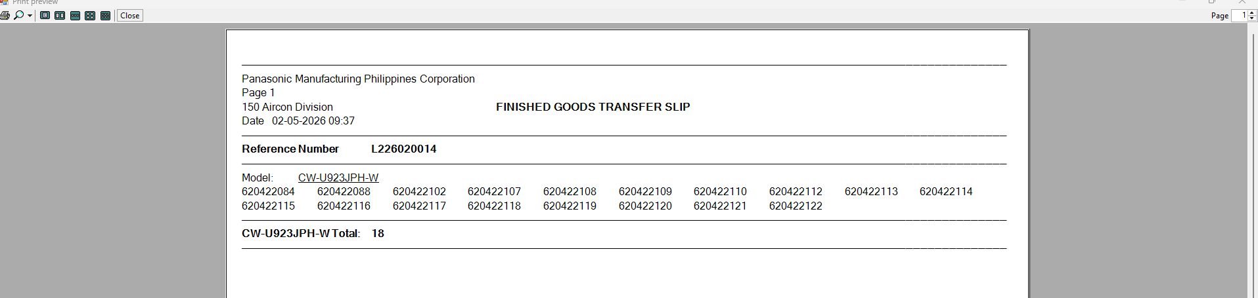
LINE AUTOMATION PROPOSAL
TRANSFER SLIP

Slide 31
SCOREBOARD
LINE 1
FEBRUARY 18, 2026
SHIFT: DAY
MODEL
PLAN
STATUS
CW-XXXXX1
200
DONE
CW-XXXXX2
500
ON-GOING
CW-XXXXX3
300
NOT YET STARTED
ON-GOING PRODUCTION
MODEL
RUNNING
SCHEDULE
RUNNING
ACTUAL
VARIANCE
STATUS
!
CW-XXXXX2
343
24
319
Behind
Note (Variance):
Behind (Red) : more than -20
Behind (Yellow): less than -20
On-Time (Yellow-Green): 0
On-Time (Green): positive value

Slide 32
SCOREBOARD
LINE 1
FEBRUARY 18, 2026
SHIFT: DAY
MODEL
SERIAL
STATUS
REMARKS
CW-XXXXX1
1XXXXXXX1
NO GOOD
NO GOOD AT RUNNING
CW-XXXXX1
1XXXXXXX2
NO GOOD
NO GOOD AT PACKING
CW-XXXXX1
1XXXXXXX3
GOOD
GOOD
CW-XXXXX1
1XXXXXXX4
GOOD
GOOD
CW-XXXXX2
12XXXXX60
GOOD
GOOD

